Slide 1
Where does Finland stand - and move - in digital finance
Olli Rehn, Member of the Board, Bank of Finland
Opening keynote
Future Digital Finance Forum
Korjaamo, Helsinki
26 April 2017

Slide 2
Percentage of population using financial services over the internet
Eurostat

Slide 3
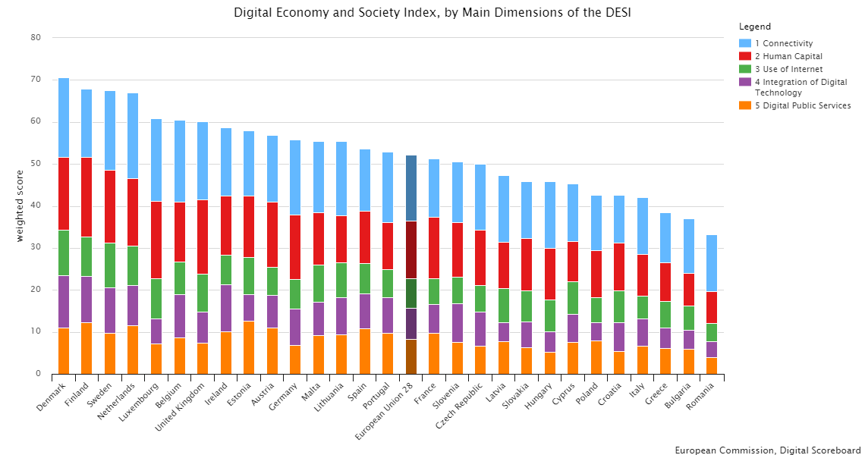
Digital Economy and Society Index

Slide 4
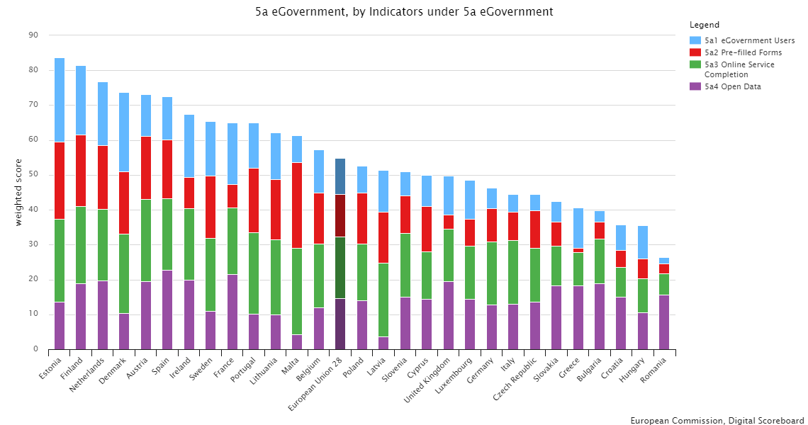
eGovernment
Finland and Estonia set up a joint institute to develop X-Road technology

Slide 5
National Income Register (kansallinen tulorekisteri)
Data about all wages and salaries are recorded
Real time data warehouse
Makes tax cards and tax returns unnecessary
Makes applying for and paying of benefits easier
National Income Register will go online 1.1.2019
Access to data is restricted – citizens can only see their own data but not other’s
Opens new possibilities for many different government and financial services

Slide 6
Finland as a digital innovator
Human Capital Index (WEF) 1st place
Digital Economy and Society Index (EU) 2nd place
Networked Readiness Index (WEF) 2nd place
Bloomberg Innovation Index 5th place
Global Talent Competitiveness Index (INSEAD) 9th place

Slide 7
Bank of Finland

Slide 8
Percentage of population using cash as the primary payment method
Federation of Finnish Financial Services

Slide 9
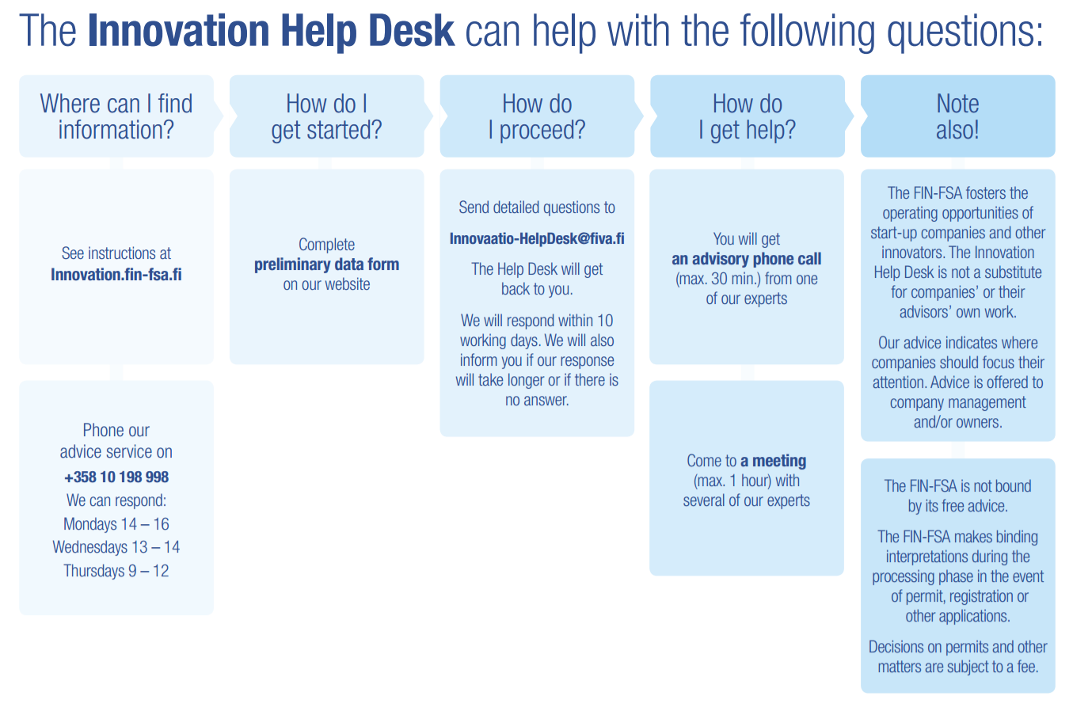
Finanssivalvonta FIN-FSA Innovation Help Desk

Slide 10
Thank you

