Slide 1
Effects of borrower-based regulation on housing demand
Rikke Rhode Nissen
RiskLab/BoF/ESRB Conference on Systemic Risk Analytics, June 2023

Slide 2
The project examines how tighter mortgage regulations affect demand across residential housing markets
Direct distributional impacts
Substitution effects
What is the distributional impact of tightening macroprudential regulation on recent buyers (households)?
What is the estimated substitution effects in terms of demand inflow and outflow from tightening regulation?

Slide 3

Tightening of LTV requirements has effects across the country while restrictions on DTI affect primarily the largest cities
Tightening (DTI) regulation creates a direct negative demand shock driven by some not buying or postponing purchase
Substitution effects counteracts direct negative impact by pushing demand out of the cities and toward smaller housing units within the city
1
2
3

Slide 4
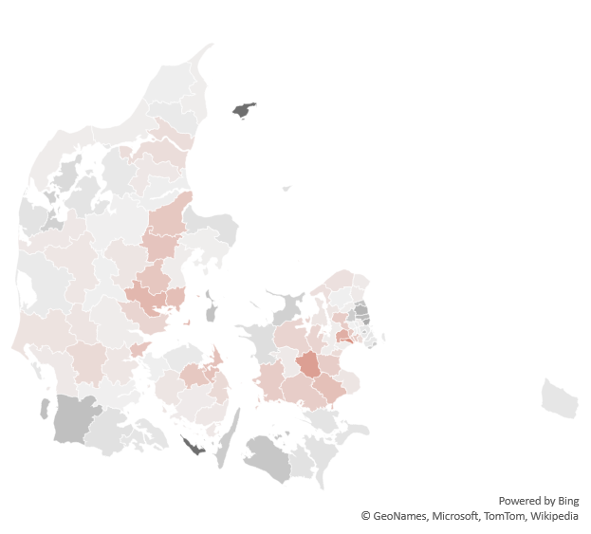
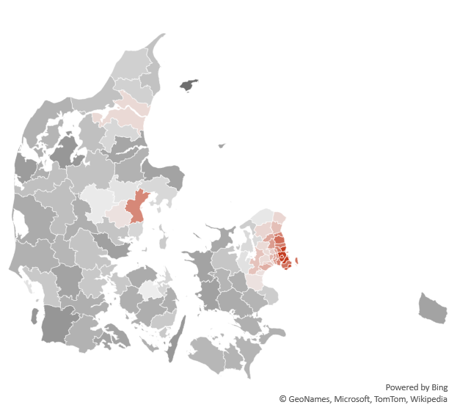
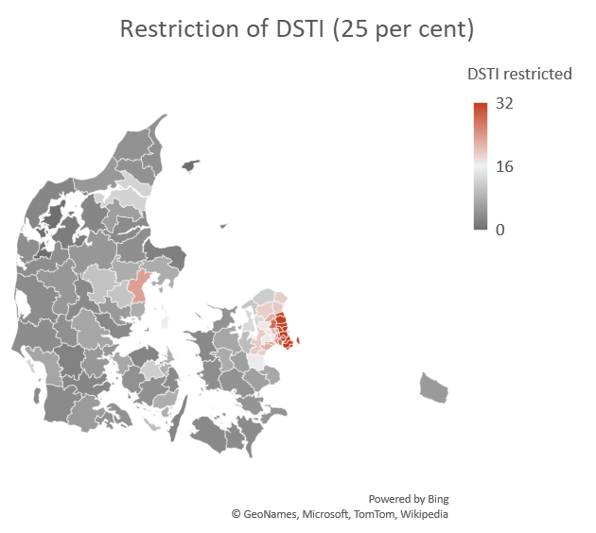
Tightening of LTV has effects across the country while restrictions on DTI affect primarily the largest cities
Tighter regulation on LTV will affect widely across Danish municipalities…
… where restrictions on DTI will mainly affect the capital region and the largest cities
Aarhus
Copenhagen
Effects of tightening LTV from 95 to 90 per cent
Effects of restrictions on DTI at 350 per cent
~ 16 per cent of households restricted

Slide 5







To study implications of tightened borrower-based measures, we first divide the housing market into 91 segments…
5 House types
30 Geographic splits
91
Segments with +100 transactions in 2017 and 2018
5 regions in Denmark
Small apartments
x
Large apartments
→
x
3 types of municipality: Urban, suburban, rural
Large single-family
homes (villas)
x
Small single-family
homes (villas)
2 zone types:
City or countryside
Terraced
houses

Slide 6

… then we define a model to predict household preferences for each segment…
Input variables
Target variable
Education
Job description at t-1
Workplace coordinates at t-1
Municipality coordinates at t-1
Family characteristics (size, children, age)
Financial information (income, wealth) at t-1
Segment of previous housing unit
Segment actually bought
Aims at revealing preferences across segments, therefore we evaluate performance based on the out-of-sample top-five accuracy → .81.
A model based only on historical flows has a top-five accuracy at .34.
 | Hovedstaden, large city, large apartment | Sjælland, province (city), small SFHs | Sjælland, rual (countrys.), small SFHs | …
Household 1 | .46 | .21 | .05 | …
Household 2 | .02 | .27 | .32 | …
… | … | … | … | …
ILLUSTRATION

Slide 7
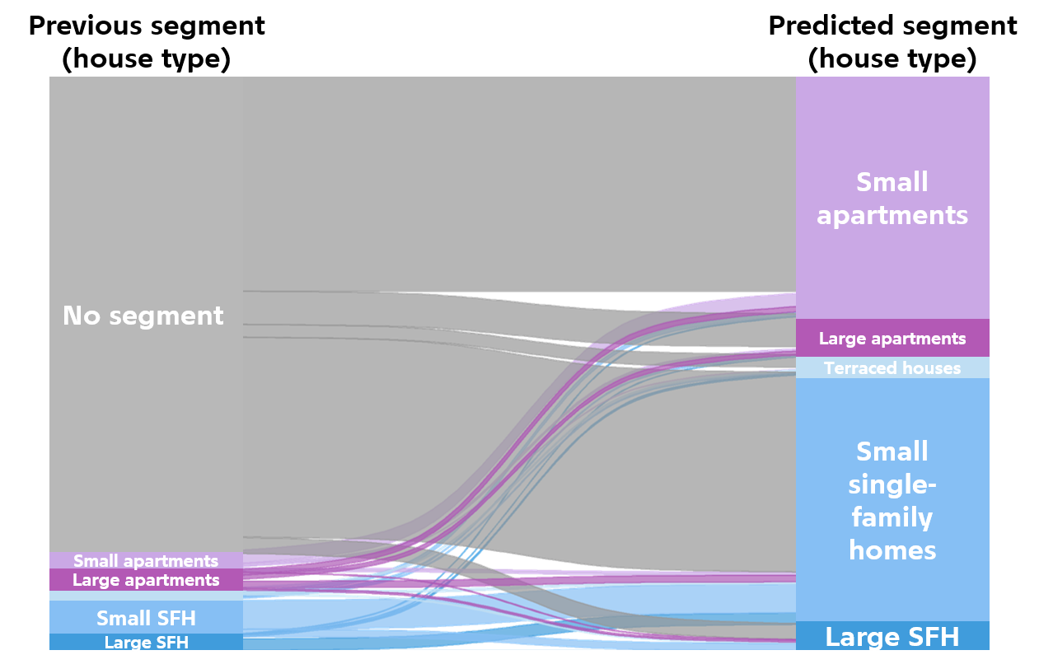
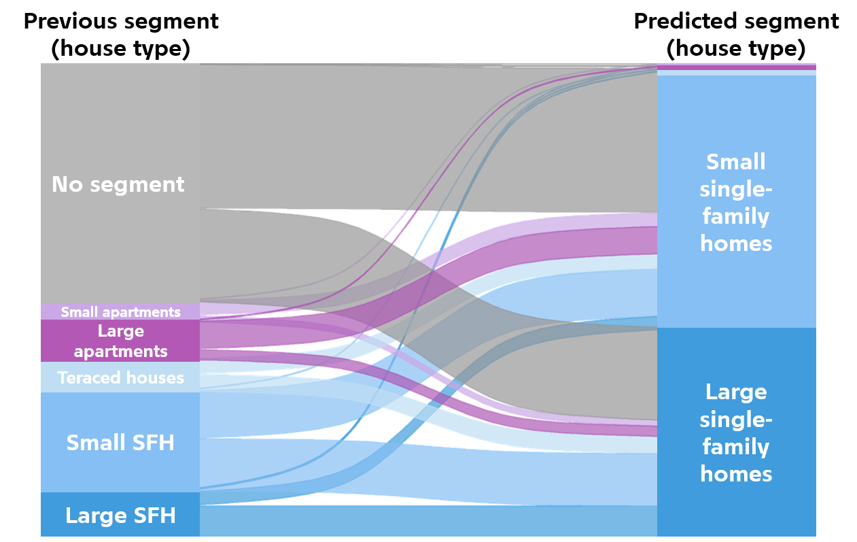
… and model households’ segment preferences given observable characteristics
Young singles are likely first-time buyers and move to small apartments and small single family houses
Families with two children primarily moves to small or large single-family houses
Outside housing market
Outside housing market
Note that the graph is only based on the most likely of the predicted segments. As we compute changes in demand we use predictions for all segments.

Slide 8
We address which segments would see increased or decreased net demand given increased DTI requirements
Direct effect
Some would stay in current housing thereby decreasing realized demand
Assumption:
20% does this
Some could not buy…
Key question
Net effect differs widely across housing segments
~ 16%
of households would not have been able to buy with a restrictions of DTI at 350%
The net effect indicates which segments that are likely to see increased or decreased demand
See next page for example
~ 16% restricted
of households would ex-post not have been able to buy with a restriction of DTI at 350%
What would these households have done if they had not been able to buy?
Substitution
Some would buy alternative subject to new DTI constraint and preferences
Assumption:
80% does this

Slide 9

Example: Substitution effects counteract direct effects in suburbs and small urban apartments in The Capital Region
Direct effects on demand from tightening DTI restrictions in 3 selected segments
Difference driven by strong space preferences
Difference driven by strong location preferences
Urban areas
Suburbs

Slide 10
Tightening of LTV requirements has effects across the country while restrictions on DTI affect primarily the largest cities
Tightening (DTI) regulation creates a direct negative demand shock driven by some not buying or postponing purchase
Substitution effects counteracts direct negative impact by pushing demand out of the cities and toward smaller housing units within the city
1
2
3

Slide 11


Thank you
Download paper

Slide 12
Back-up: Regulation on mortgage borrowing affect different types of households
Restrictions on DTI and DSTI affects low-income households relatively more
Less wealthy households are more affected by restrictions on LTV
Overrepresented by a factor of ~150% relative to nationwide share
250
150
100
200
150
100
50
-50
-50
-100

Slide 13
Back-up: Complex rules - Mortgage product supply as a function of LTV, DTI and geography
Stylized mortgage supply
DTI
No restrictions*
General guidelines binding
30-year fixed rate (incl. IO) 5-year fixed amortizing
Growth area guidelines binding
Only 30-year fixed rate amortizing**
Growth area guidelines binding
Only 30-year fixed rate amortizing**
Minimum down payment requirement binding
500 pct.
No restrictions*
General guidelines binding
30-year fixed rate (incl. IO) 5-year fixed amortizing
General guidelines binding
30-year fixed rate (incl. IO) 5-year fixed amortizing
Growth area guidelines binding
Only 30-year fixed rate amortizing**
Minimum down payment requirement binding
400 pct.
No restrictions*
No restrictions*
No restrictions*
No restrictions*
Minimum down payment requirement binding
0 pct.
60 pct.
75 pct.
90 pct.
95 pct.
LTV
* The household must be able to service a 30-year fixed rate annuity, in the growth areas with an interest rate of minimum 4 per cent.
** Rules only applicable in Copenhagen and Aarhus ("the growth areas"). In addition, the household must have "high job security" and positive net wealth at loan origination.
13

Slide 14
Back-up: Danish housing finance stands out in an international context
Counties with interest rate deductibility
(In Holland only if also amortization)
Countries without interest rate deductibility
No amortization requirement
DK
Amortization requirement for high LTV
SE
NL
SK
RO
LV
Amortization requirement
AT
SI
NO
PT
CZ
IE
EE
FI
HU
CY
IS
BE
MT
Down payment requirement
PL
LT
LU
20 %
15 %
10 %
5 %
0 %
The figure contains countries that have a statutory down payment requirement. In several countries there is no legal obstacle
to granting interest-free mortgage loans, but the spread is very small, which is why the country is marked as "No interest-free".
14
Kilde: EMF, ESRB, OECD.

